Slide 1
Compiler Construction (Introductory Class)

Slide 2
Outline
Class Introduction
Course Introduction
Course Outline

Slide 3
Outline
Class Introduction
Course Introduction
Course Outline

Slide 4
Course Title: Compiler Construction
Course Code: CSTE 3111
Google Classroom Code: l4squkr

Slide 5
Outline
Class Introduction
Course Introduction
Course Outline

Slide 6
Credit Hours: 3.00
Textbook(s):
Compilers- Principles, Techniques, and Tools
Alfred V. Aho, Ravi Sethi, Jeffrey D. Ullman
Resources: Textbook and Lecture slides

Slide 7
Outline
Class Introduction
Course Introduction
Course Outline

Slide 8
Why study compiler construction?
Writing a compiler gives a student experience with large-scale applications development. Your compiler program may be the largest program you write as a student.
Experience working with really big data structures and complex interactions between algorithms will help you out on your next big programming project.
Compiler writing is one of the shining triumphs of Computer Science theory.
It demonstrates the value of theory over the impulse to just "hack up" a solution.
Compiler writing is a basic element of programming language research. Many language researchers write compilers for the languages they design.
Many applications have similar properties to one or more phases of a compiler, and compiler expertise and tools can help an application programmer working on other projects besides compilers.

Slide 9
Introduction to language processing
As Computers became inevitable and indigenous part of human life, and several languages with different and more advanced features are evolved into this stream to satisfy or comfort the user in communicating with the machine,
the development of the translators or mediator software‘s have become essential to fill the huge gap between the human and machine understanding.
This process is called Language Processing to reflect the goal and intent of the process.

Slide 10
Language Translator
Language Translator is a computer program which translates a program written in one (Source) language to its equivalent program in other (Target) language.
The Source program is a high level language where as the Target language can be any thing from the machine language of a target machine (between Microprocessor to Supercomputer) to another high level language program
Two commonly Used Translators are:
Compiler
Interpreter

Slide 11
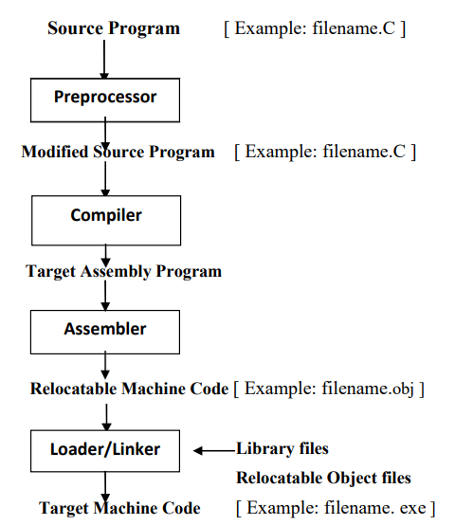
Language Processing System

Slide 12
Preprocessor
A preprocessor takes the skeletal source program as input and produces an extended version of it, which is the resultant of expanding the Macros, manifest constants if any, and including header files etc. in the source file.
For example, the C preprocessor is a macro processor that is used automatically by the C compiler to transform a source program before actual compilation.
Over and above a preprocessor performs the following activities:
Collects all the modules, files in case if the source program is divided into different modules stored at different files.
Expands short hands / macros into source language statements.

Slide 13
Compiler
Compiler is a translator that takes as input a source program written in high level language and converts it into its equivalent target program in machine language.
In addition to above the compiler also:
Reports to its user the presence of errors in the source program.
Facilitates the user in rectifying the errors, and execute the code.

Slide 14
Assembler
Assembler is a program that takes as input an assembly language program and converts it into its equivalent machine language code.

Slide 15
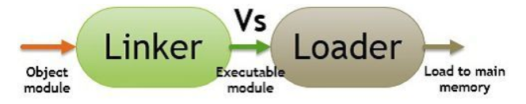
Loader/Linker
Linker and Loader are the utility programs that plays a major role in the execution of a program.
The Source code of a program passes through compiler, assembler, linker, loader in the respective order, before execution. On the one hand, where the linker intakes the object codes generated by the assembler and combine them to generate the executable module.
On the other hands, the loader loads this executable module to the main memory for execution.

Slide 16
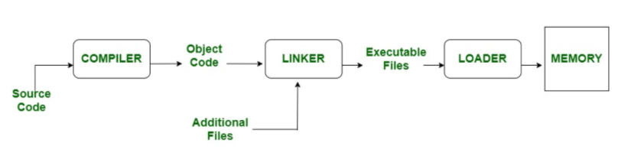
Loader/Linker (Contd.)
This is a program that takes as input a relocatable code and collects the library functions, relocatable object files, and produces its equivalent absolute machine code.
Specifically,
Loading consists of taking the relocatable machine code, altering the relocatable addresses, and placing the altered instructions and data in memory at the proper locations.
Linking allows us to make a single program from several files of relocatable machine code. These files may have been result of several different compilations, one or more may be library routines provided by the system available to any program that needs them.

Slide 17
Loader/Linker (contd.)
A linker is special program that combines the object files, generated by compiler/assembler, and other pieces of codes to originate an executable file have. exe extension.
In the object file, linker searches and append all libraries needed for execution of file.
It regulates the memory space that will hold the code from each module.
It also merges two or more separate object programs and establishes link among them.

Slide 18
Loader/Linker (contd.)
The loader is special program that takes input of executable files from linker, loads it to main memory, and prepares this code for execution by computer.
Loader allocates memory space to program.
Even it settles down symbolic reference between objects.
It is in charge of loading programs and libraries in operating system.
The embedded computer systems do not have loaders. In them, code is executed through ROM.

Slide 19
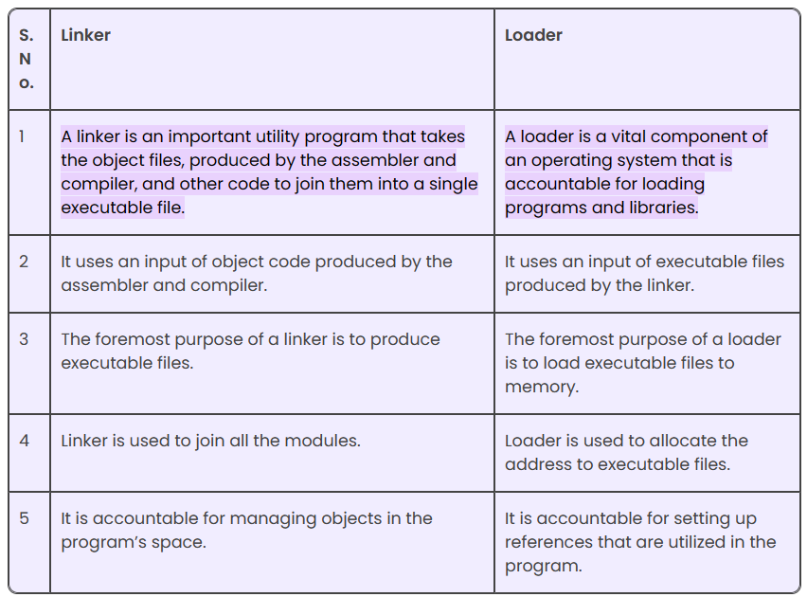
Linker VS Loader

Slide 20
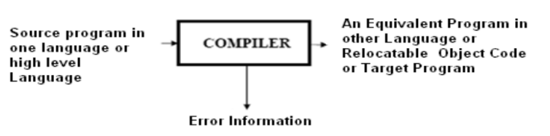

Compiler
Compiler is a program, reads program in one language called Source Language and translates into its equivalent program in another Language called Target Language, in addition to this its presents the error information to the User.
If the target program is an executable machine-language program, it can then be called by the users to process inputs and produce outputs.

Slide 21

Interpreter
An interpreter is another commonly used language processor.
Instead of producing a target program as a single translation unit, an interpreter appears to directly execute the operations specified in the source program on inputs supplied by the user.

Slide 22
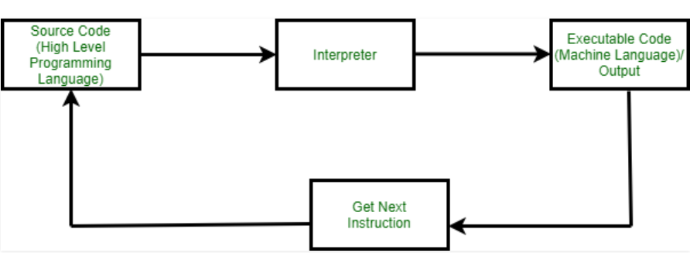
Interpreter (Contd.)
The translation of a single statement of the source program into machine code is done by a language processor and executes immediately before moving on to the next line is called an interpreter.
If there is an error in the statement, the interpreter terminates its translating process at that statement and displays an error message.
The interpreter moves on to the next line for execution only after the removal of the error.
An Interpreter directly executes instructions written in a programming or scripting language without previously converting them to an object code or machine code.

Slide 23
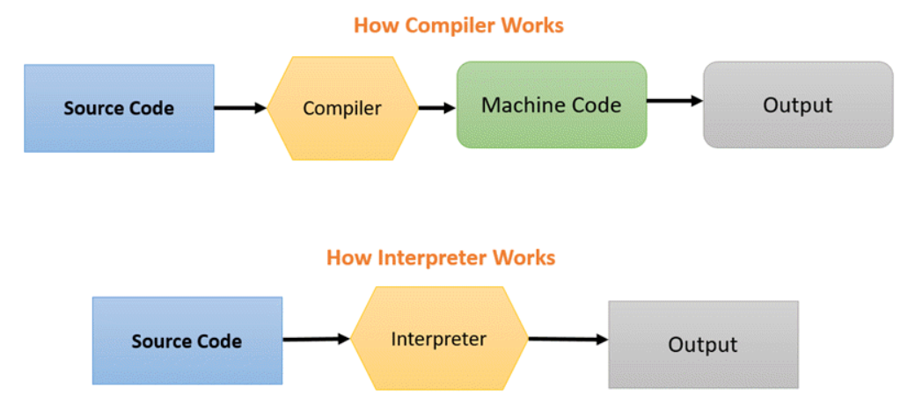
Compiler VS Interpreter
Both compiler and interpreters do the same job which is converting higher level programming language to machine code.
However, a compiler will convert the code into machine code (create an exe) before program run. Interpreters convert code into machine code when the program is run.

Slide 24
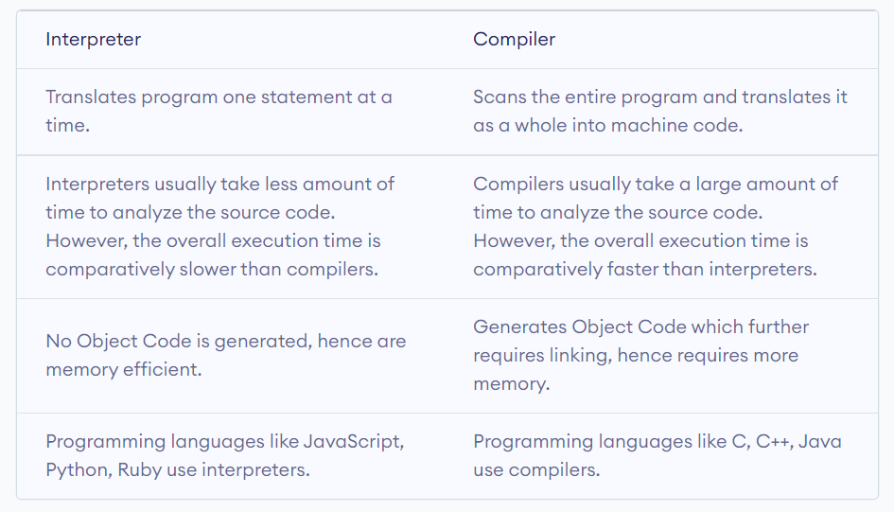
Differences between interpreter and compiler

Slide 25
Types of Compilers
Based on the specific input it takes and the output it produces, the Compilers can be classified into the following types;
Traditional Compilers(C, C++, Pascal): These Compilers convert a source program in a HLL into its equivalent in native machine code or object code.
Interpreters(LISP, SNOBOL, Java1.0): These Compilers first convert Source code into intermediate code, and then interprets (emulates) it to its equivalent machine code.
Cross-Compilers: These are the compilers that run on one machine and produce code for another machine. For example, a compiler that runs on a PC but generates code that runs on Android smartphone is a cross compiler.
Incremental Compilers: These compilers separate the source into user defined–steps; Compiling/recompiling step- by- step; interpreting steps in a given order. For example, C/C++ GNU Compiler, Java eclipse platform, etc.

Slide 26
Types of Compilers (Contd.)
Converters (e.g. COBOL to C++): These Programs will be compiling from one high level language to another.
Just-In-Time (JIT) Compilers (Java, Micosoft.NET): These are the runtime compilers from intermediate language (byte code, MSIL) to executable code or native machine code. These perform type –based verification which makes the executable code more trustworthy
Ahead-of-Time (AOT) Compilers (e.g., .NET): These are the pre-compilers to the native code for Java and .NET.
Binary Compilation: These compilers will be compiling object code of one platform into object code of another platform.

Slide 27
Phases of a Compiler
Due to the complexity of compilation task, a compiler typically proceeds in a sequence of compilation phases.
The phases communicate with each other via clearly defined interfaces.
Generally an interface contains a Data structure (e.g., tree), Set of exported functions.
Each phase works on an abstract intermediate representation of the source program, not the source program text itself (except the first phase).
Compiler Phases are the individual modules which are chronologically executed to perform their respective Sub-activities, and finally integrate the solutions to give target code.

Slide 28
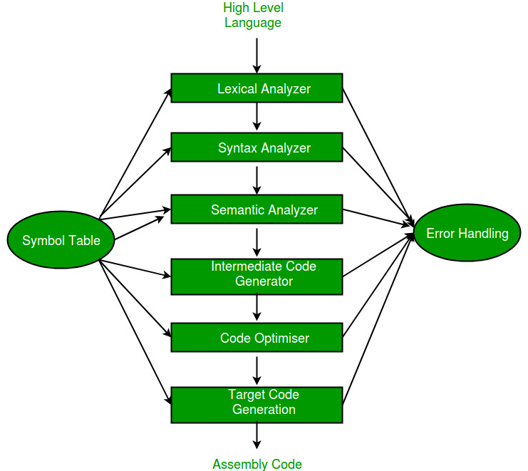
Phases of a Compiler (Contd.)

Slide 29
Phases of a Compiler (Contd.)
Lexical Analysis:
Converts a sequence of characters into words, or tokens.
Syntax Analysis:
Converts a sequence of tokens into a parse tree.
Semantic Analysis:
Manipulates parse tree to verify symbol and type information.
Intermediate Code Generation:
Converts parse tree into a sequence of intermediate code instructions.
Optimization:
Manipulates intermediate code to produce a more efficient program.
Final Code Generation:
Translates intermediate code into final (machine/assembly) code.

Slide 30
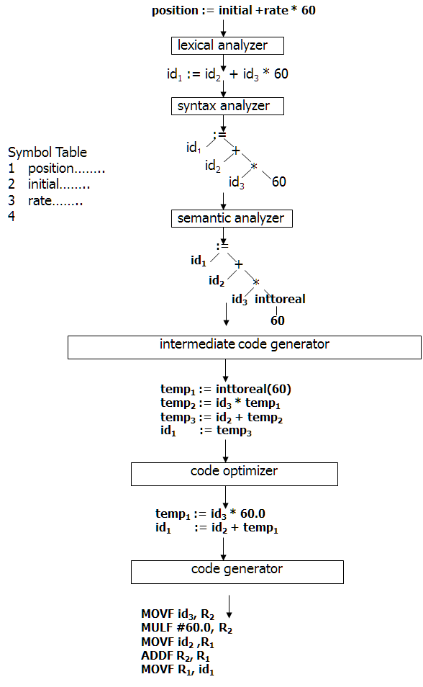

Slide 31
Phases of a Compiler (Contd.)
In addition to these, it also has Symbol table management, and Error handler phases.
Not all the phases are mandatory in every Compiler. e.g., Code Optimizer phase is optional in some cases.

Slide 32
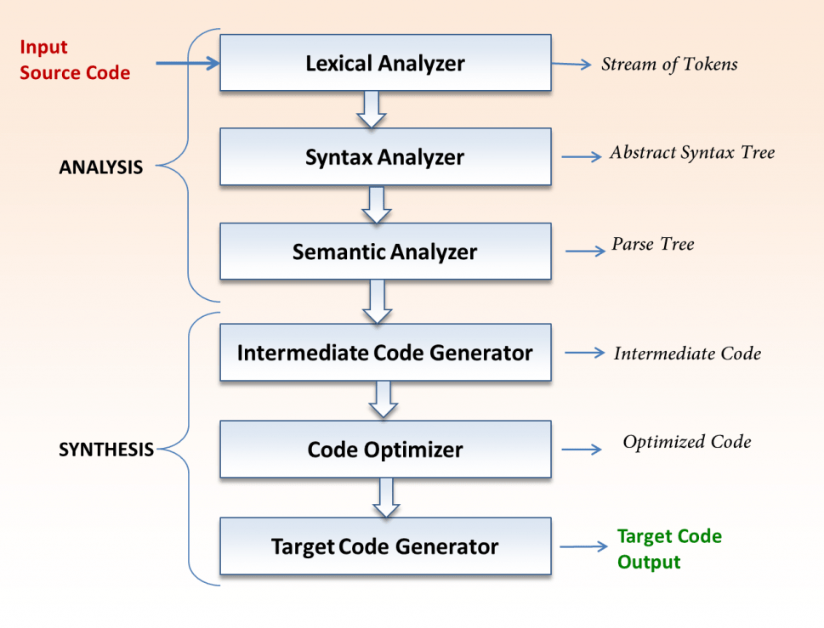
Phases of a Compiler (Contd.)
The Phases of a compiler divided in to two parts,
The first three phases we are called as Analysis part, and
The remaining three called as Synthesis part.

Slide 33
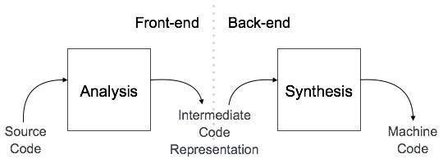
Compiler Design Architecture
All of these phases of a general Compiler are conceptually divided into The Front-end, and The Back-end.
This division is due to their dependence on either the Source Language or the Target machine.
This model is called an Analysis & Synthesis model of a compiler.

Slide 34
Compiler Design Architecture (Contd.)
The Front-end of the compiler consists of phases that depend primarily on the Source language and are largely independent on the target machine.
For example, front-end of the compiler includes Scanner, Parser, Creation of Symbol table, Semantic Analyzer, and the Intermediate Code Generator.
The Back-end of the compiler consists of phases that depend on the target machine, and those portions do not dependent on the Source language, just the Intermediate language.
In this we have different aspects of Code Optimization phase, code generation along with the necessary Error handling, and Symbol table operations.

Slide 35
THANK YOU!!!

